Slide 1
Chapter 9
Sleep and Biological Rhythms

Slide 2
How do we define sleep?
Sleep is a reversible state of reduced awareness of and responsiveness to the environment. Usually it occurs when lying down quietly with little movement
Humans have three normal behavioural states of existence: wakefulness, non rapid eye movement (NREM) sleep and rapid eye movement (REM) sleep
Sleep stages and wakefulness can be defined through various physiological measures

Slide 3
Biological rhythms
Physiological time has a rhythmical character:
Circadian – around a day, 24 hours e.g. sleep-wake cycle
Ultradian – less than a day, cycles that occur within a day e.g. temperature fluctuations, cognitive vigilance, sleep stages
Infradian – more than a day
e.g. menstrual cycle
Notes:
Our sleep-wake cycle is governed by the circadian clock.

Slide 4
The suprachiasmatic nucleus (SCN)
Via neurons of the retinohypothalamic path
Sleep-inducing reactions
lowered body temperature and
blood pressure
melatonin binding to receptors in the SCN
PER gene for biological clock, was involved in all three mutations of fly (Stanewsky, 2003)
Mammals also carry the same gene, but it is referred to as the clock gene (King & Takahashi, 2000)

Slide 5
SCN
Transect optic nerve before optic chiasm – no light/dark entrainment
Transect optic nerve after optic chiasm – preserved light/dark entrainment
Retinohypothalamic tracts – to SCN

Slide 6
Circadian rhythms and SCN
SCN projects directly to cholinergic basal forebrain and posterior hypothalamus which influence cortical arousal
SCN is influenced by light and other ‘zeitgebers’ – ‘time givers’, including social cues, noise, temperature

Slide 7
Circadian rhythms and melatonin
Light influences the hypothalamus via retino-hypothalamic tracts from optic chiasm
Light suppresses SCN firing and this in turn suppresses pineal production of melatonin
Melatonin is a neuro-endocrine marker of darkness

Slide 8
Sleepiness over a 24-hour period

Slide 9
Patterns of sleep and wakefulness
Age and condition | Average amount of sleep per day
Newborn | up to 18 hours
1–12 months | 14–18 hours
1–3 years | 12–15 hours
3–5 years | 11–13 hours
5–12 years | 9–11 hours
Adolescents | 9–10 hours
Adults, including elderly | 7–8 (+) hours
Pregnant women | 8 (+) hours

Slide 10
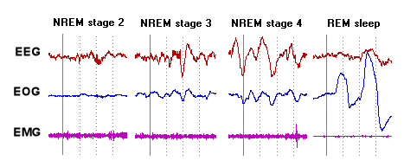
Measuring sleep
Electroencephalogram (EEG): Measures electrical activity of the brain
Electrooculogram (EOG): Measures eye movements
Electromyogram (EMG): Measures electrical activity of the muscles
Actigraphy: sensor measures gross motor activity

Slide 11
Sleep stages
Stage 1 refers to the transition of the brain from alpha waves to theta waves (theta activity)
Stage 2 sleep – no eye movement or theta activity. There are sleep spindles, 1-2 second bursts of 12-14 Hz activity, and K complexes
Stage 3 sleep – very slow brain waves (delta waves) that have a frequency of
1-4Hz
Stage 4 – delta waves predominate for a deeper level of sleep
REM (‘paradoxical’) sleep

Slide 12
EEG tracings

Slide 13
Ponto-geniculo-occipital waves or PGO waves
The appearance of ponto-geniculo-occipital waves (PGO waves) is the initial sign that REM sleep has started
Phasic electrical bursts of neural activity that begin in the pons to
lateral geniculate nucleus in the hypothalamus
terminate in the occipital primary visual cortex
Just before REM sleep, PGO waves are observed; therefore, PGO waves may be linked to dreaming
PGO waves may be responsible for the rapid eye movement

Slide 14
Sequences of NREM & REM sleep
70–90 minutes of NREM sleep
The stages being ordered 1–2–3–4–3–2
First period of REM sleep, which may last between 5 and 15 minutes
NREM-REM cycles
REM becomes longer
REM sleep makes up nearly 25%

Slide 15
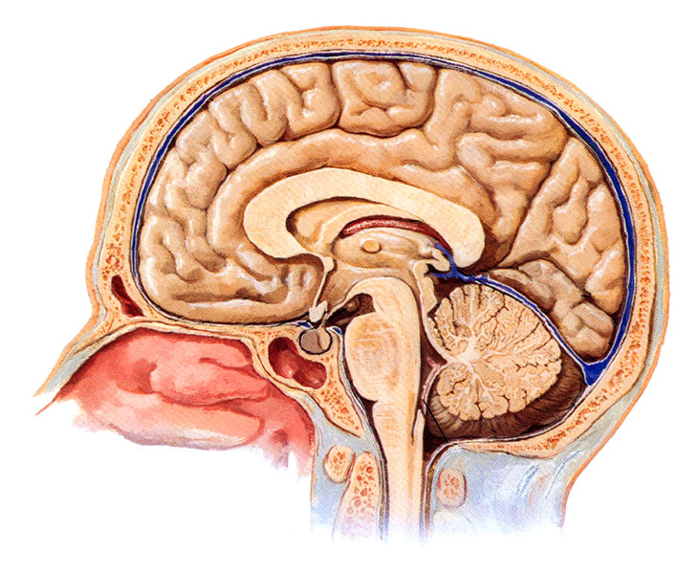
Brain stem control of sleep and wakefulness
Lesion at ‘A’ in the cat brain (cerveau isolé), between inferior and superior colluculi, disconnects forebrain from most sensory input
Produces a continuous sleep-like state
A
Passive Sensory Theory (Bremer, 1936)
Sleep due to reduced sensory input to forebrain
Notes:
Bremer did feline transection experiments in the 1930s.

Slide 16
Brain stem control of sleep and wakefulness
Lesion at ‘B’ (encéphale isolé) disconnects brain from nervous system
Maintains normal sleep-wake cycles
A
B
(Bremer, 1937)
Notes:
Bremer did feline transection experiments in 1930s

Slide 17
Brain stem control of sleep and wakefulness
A lesion at ‘A’ in the cat brain (cerveau isolé) produces a continuous sleep-like state
A lesion at ‘B’ (encéphale isolé) maintains sleep-wake cycles
A
B
The area between A and B includes a sleep centre (reticular formation/reticular activating system or RAS) which can actively rouse the cortex independent of external stimuli
Notes:
Bremer did feline transection experiments in 1930s.

Slide 18
Active reticular activation system theory
(Moruzzi & Magoun, 1949)
Lesion ‘A’ (cerveau isolé) – sleep
Lesion ‘B’ (encéphale isolé) – normal sleep/wake
Lesion ‘C’ (midcollicular level) damages reticular formation, leaves sensory fibres – sleep
Stimulation at ‘D’ (pontine reticular formation) – wakefulness
A
C
D
B
Notes:
Bremer did feline transection experiments in 1930s.

Slide 19
Neurotransmitters & neuromodulators of sleep
Serotonin
Promotes wakefulness, inhibits REM sleep, processing sensory information, generation of waking-related motor activity. Serotonergic cells in dorsal raphe nucleus of brain stem (reticular formation)
Noradrenaline
Inhibits REM sleep, locus coeruleus (pons) noradrenergic neurons excite spinal motoneurons, in cataplexy locus coeruleus neurons cease discharging
Acetylcholine
Promotes REM sleep and EEG arousal, medial pontine reticular formation ACh release increases in REM sleep

Slide 20
Neurotransmitters & neuromodulators of sleep
Adenosine
Promotes slow wave NREM sleep by inhibiting cholinergic neurons. Basal forebrain structures important. Possibly builds up when awake to sufficient quantities to promote sleep
Dopamine
Systems promote wakefulness, vigilance & performance enhanced by dopamine agonists, dopamine antagonists impair performance and more likely to fall asleep. Complex interactions poorly understood
Histamine
Neurons from posterior hypothalamus promote wakefulness. Anti-histamines produce drowsiness
Hypocretin/Orexin
A peptide produced by cells whose bodies are located in the lateral hypothalamus. Involved with regulating the sleep on/off cells in the ventro-lateral pre optic area (VLPA). Cell destruction – narcolepsy

Slide 21
Why do we sleep? Evolutionary/adaptive
Explain the long sleep cycles of babies as a result of protecting their caregiver from exhaustion, thus increasing the babies’ survival chances (Meddis, 1975)
Hibernation theory (Webb, 1974) – a variation of evolutionary theory suggests the main reason that elaborate sleep mechanisms have evolved is to keep at rest when it is dark

Slide 22
Repair & restoration theory of sleep
The repair and restoration theory of sleep holds that sleep is critical for revitalizing and restoring the physiological processes that permit the body and mind to function in a correct and healthy manner (Oswald, 1966)

Slide 23
Theories of REM sleep
Re-evaluate facts and events experienced during the previous day (Wagner et al., 2004)
Dumping ground for unwanted information (Crick & Mitchison, 1983)
Activation-synthesis theory (Hobson & McCarley, 1977; Hobson, 1989)
Improved performance of complex tasks (Stickgold, 2004)

Slide 24
Functions of sleep thought to include…
REM sleep…
Establishing new behaviour patterns and emotional responses
Consolidating memories
Mood and emotion regulation
NREM Stages 1-4…
Conservation of energy
Restoration
Cell division in some tissues is most rapid
Protein synthesis is increased

Slide 25
Sleep deprivation
Controlling for the method used to cause sleep deprivation
Experimental rat 87% sleep loss; control rat 31% sleep loss
Grooming, uncoordinated, temperature regulation, increased feeding, death
Randy Gardner (1965)
260 hours

Slide 26
Effects of sleep disruption
Physical
Growth
Immune system
Death!
Motor skills
Hand-eye coordination
Reaction time
Cognition
Memory
Attention
Divergent thinking

Slide 27
Effects of sleep disruption (cont.)
Performance
Work/school
Accidents
Mood and behaviour
Fatigue/overactivity
Irritability/aggression
Anxiety/depression
Hallucinations

Slide 28
Sleep problems vs sleep disorders
3 presenting problems
Sleeplessness
Excessive sleepiness
Events/behaviours associated with
sleep
Over 80 sleep disorders listed in International Classification of Sleep Disorders (2nd edn)
(ASDA, 2005)

Slide 29
Sleep hygiene
Sleeping environment should be conducive to sleep
Familiar setting
Comfortable bed, darkened, quiet room, correct temperature
Non-stimulating
No negative associations
Encourage
Bedtime routines
Consistent bedtime and waking up times (weekdays, weekends, holidays); consistent daytime timing of all meals
Thinking about problems and plans before going to bed
Regular daily exercise, exposure to sunlight

Slide 30
Sleep hygiene
Avoid
Over-excitement near bedtime
Late evening exercise
Caffeine-containing drinks late in the day (that includes cola and most chocolate drinks)
Large meals late at night (a light snack is good if it prevents hunger)
Excessive or late napping during the day
Too much time awake in bed (especially if distressed)

Slide 31
International Classification of Sleep Disorders (2nd edn) (ASDA, 2005)
Insomnia
Sleep-related breathing disorders
Hypersomnias of central origin
Circadian rhythm sleep disorders
Parasomnias
Disorders of arousal (NREM)
REM sleep parasomnias
Other parasomnias
Sleep-related movement disorders
Isolated symptoms/normal variants/unresolved
Other

Slide 32
Insomnia
Difficulty initiating or maintaining sleep or non-restorative sleep for at least one month (4 nights p/w)
Clinically significant distress/impairment
Not exclusively due to another sleep disorder, mental disorder or effects of a substance
Insomnia at the first assessment increases the risk of developing first-onset depression, an anxiety disorder or alcohol problems

Slide 33
Obstructive sleep apnoea
Sleep-related breathing disorder
Total/partial cessation of breathing >10 seconds
Arousals
Unrefreshed after sleep
Excessive daytime sleepiness
Snoring/noisy breathing
Body movements
Affects 2-4% of population
Male, overweight, alcohol, nasopharyngeal abnormalities
Notes:
Associated with:
Night wakes
Mood disorders
Hypertension
Cardiac arrhythmias

Slide 34
Hypersomnia narcolepsy
Disorder of neural control mechanisms regulating sleep and wake
Repeated sleep attacks
Cataplexy (loss of muscle tone)
Hypnagogic hallucinations/sleep paralysis
Peak incidence age 14 years
Affects 0.1% of general population
Notes:
Genetic basis

Slide 35
Parasomnia sleep paralysis
Preservation of muscle atonia during transition from wakefulness; intrusion of alpha rhythm into REM sleep
Full consciousness and recall
Hallucinations in 25-75%
Aborted by sensory stimulation

Slide 36
Circadian rhythm sleep disorders
The timing of sleep
Unable to sleep and wake at the times required for normal work, school and social needs
They are generally able to get enough sleep if allowed to sleep and wake at the times dictated by their body clocks
Unless they have another sleep disorder, their sleep is of normal quality

Slide 37
Arousal disorders
Partial arousal from SWS
Confusional arousals (17% children; 3-4% adults)
Sleepwalking (17% children; 3-4% adults)
Sleep terrors (1-6.5% children; 2.2% adults)

Slide 38
Arousal disorders are different from nightmares…
Sleep stage
Timing
Intensity
Mental content
Violent behaviour
Injury
Memory for event
Ability to arouse
Family history

Slide 39
REM sleep behaviour disorder
Preservation of muscle tone during REM sleep
Acting out dreams
Increase in violent/action-filled dreams
Older males
40% associated with neurological disorders; 60% idiopathic
Notes:
.5% in elderly. .38% in general pop

Slide 40
Other parasomnias
Exploding head syndrome
Sleep enuresis
Sleep groaning (catathrenia)

Slide 41
Restless legs syndrome (RLS)/periodic limb movement disorder (PLMD)
RLS – uncomfortable tingling/crawling sensations in the legs during periods of inactivity, reduced by movement
PLMD – brief (0.5-5sec) periodic, stereotypic repetitive movements every 20-40 seconds, series >4, which may be associated with cortical arousal

Slide 42
Mechanisms of sleep

Slide 43
Stages of sleep

Slide 44
Theories of sleep

Slide 45
Disorders of sleep

Slide 46
Sleep

Slide 47
Readings
Barnes, J. (2011). Essential Biological Psychology (Chapter 9). London: Sage.
The Essentials
Crick, F., & Mitchison, G. (1983). The function of dream sleep. Nature, 304(5922), 111-114.
Next Steps
Moore, R.Y. (2007). Suprachiasmatic nucleus in sleep-wake regulation. Sleep Medicine Reviews, 8(Suppl. 3), 27-33.
Delving Deeper
Matwiyoff, G., & Lee-Chiong, T. (2010). Parasomnias: an overview. Indian Journal of Medical Resources, 131, 333-337.

